Slide 1
MHDO Secure Data Access: NORC Data Enclave
Demo 2024
Notes:
Notes Page Title Here
(edit this in notes view)

Slide 2
Overview of the
What is the Data Enclave?
Secure, remote access to confidential data
Initial launch sponsored and guided by the National Institute of Standards and Technology (NIST)
Provides a robust analytic platform that enforces secure and compliant access to data
Securely stored and provided access to MHDO data since 2012
Notes:
Note context

Slide 3
Data Enclave Platform
Platform + Tools Approach:
Fully managed infrastructure – users focus on analysis
Draws upon existing skills and user communities for analytic tools and support
Flexible/interoperable tools accommodate development and growth

Slide 4
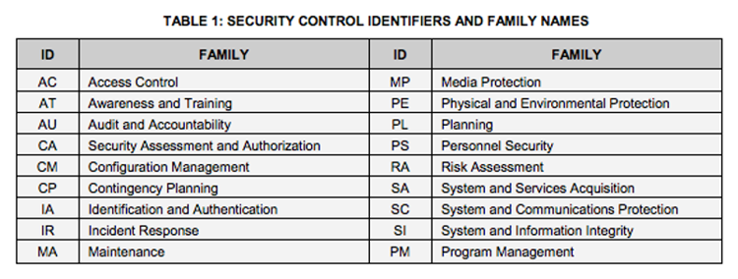
Data Enclave Security
NIST 800-53 Rev5 compliance at the moderate control level
Ensures ongoing maintenance of policies and procedures surrounding key areas of operations
Notes:
800-53 is the canonical security standard for all federal agencies
Disaster recovery, configuration management, and incident response
Note Amazon shared security model: AWS only guarantees the security of the cloud, customers are responsible for security *in* the cloud
https://aws.amazon.com/compliance/shared-responsibility-model/

Slide 5
Data Enclave User Management
Microsoft Active Directory Services
User account and permissions requests are processed in the Data Enclave using a ticketing system
Account configuration details are captured in the ticket and implemented by IT staff
Views will be provisioned based on MHDO Data Request/Release Procedures
Notes:
Given a platform environment, how are users created and managed?

Slide 6
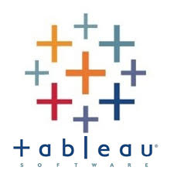
Data Enclave Platform
Default Applications included in all Data Enclave accounts:
R/RStudio, Stata, Python and Stat/Transfer
Note: Python is supported by Spyder and Jupyter
DBeaver
Notepad++
Firefox
Microsoft Edge
Acrobat Reader DC
Microsoft Office 2013 (Word, Excel, PowerPoint)
Windows Accessories (Snipping tool, Calculator, etc.)
7-Zip File Manager
File Explorer (Stores flat files)
Requested Software Requiring Licensing Costs:
ArcGIS
GAMS
GAUSS
HLM
Matlab
SAS
SPSS
Tableau (User License Required)
UltraEdit

Slide 7
Data Enclave User Information
Specifications | Direct Data Access in Data Enclave Analyst (Standard Subscription Fee) | Direct Data Access in Data Enclave Custom Project (DE Estimated Fee)
Data Access & Formats | Access database tables/views in Vertica HP (read only) | On request, requiring Feasibility Assessment and Estimating by NORC
Storage for data files, reports, spreadsheets, documents | 50 GB personal H Drive: 200 GB shared storage available for the research team | Custom Database Storage + Custom File Storage as agreed with NORC
Database Software | Vertica HP database with Dbeaver SQL Client Tool | Vertica HP database with Dbeaver SQL Client Tool + Other Data Management Tools if supported by NORC Data Enclave
Data Analysis Software | STATA, R Studio, Python Access to Tableau Desktop with provision of external license | SAS, SPSS, ArcGIS+ Other Data Analysis Software, if supported by DE For Additional Software, customer may need to provide license; software must be Citrix compatible
Presentation Software | Microsoft Office Productivity Suite - Excel, PPT, Word, etc. | Microsoft Office Productivity Suite - Excel, PPT, Word, etc.
Download Files/Reports | 5 SDC-reviewed export requests per month (Aggregated Data files, Reports) | Custom Number of Downloads and Size, as agreed with NORC
Upload 3rd Party Data | 50 GB for Ancillary Data Files | Custom Number of Uploads, as agreed with NORC
Support Tier Description | 2-day response service level agreement (SLA) for technical issues, defined as: account management, application launch failure, and database connectivity errors. | 1 day response service level agreement (SLA) for technical issues, defined as: account management, application launch failure, and database connectivity errors.
Training | Self-guided onboarding to Data Enclave/MHDO Data via FAQs and short web-based video. 1-hour initial environment and data access training | Self-guided onboarding to Data Enclave/MHDO Data via FAQs and short web-based video. 1 hour initial environment and data access training
Data Objects Permissions | Read only access to data views for all available years in Vertica (low memory and temp table limits) | Tables/Views can be migrated to PROD (persistent) by NORC IT only
Database New Objects development | Creation of Temporary tables in Vertica is allowed | Creation of Temporary tables in Vertica is allowed
Request Process | Request and Approval by MHDO/and NORC Data Enclave Database Managers | Project Request and Approval to MHDO/scope & feasibility assessments by NORC
NORC Fee Structure | Hosting Fee Per User/Per Year = $5,356 | Hosting Fee Per User/Per Year = $5,356 1 TB Vertica Storage ~ $10K / 1 TB 1 TB File Storage ~ $2,000 / 1 TB

Slide 8
USM Questions
How is it structured? Would someone have their own working folder where once could create working datasets from the APCD to use.
Yes, users will have both their own folder and there can be a shared group folder with other USM staff.
Is there SAS ,STATA. EXCEL, WORD on the environment to create working files and do analysis?
Yes, these tools are all available. SAS does have an additional monthly fee of $164/month.
Would others be able to have access to say a share folder where the project was and the data set etc.?
Yes
If one created tables to be used in a paper for example would they be able to be downloaded and output to an external USM folder or somewhere to add into a working paper within a USM computer?
As long as the DUA with MHDO allows for this.
Is there a limit on data size ?
There are limits per account, but additional space can be purchased.
What hours is the enclave available to use?
24/7 with schedule maintenance windows.

Slide 9
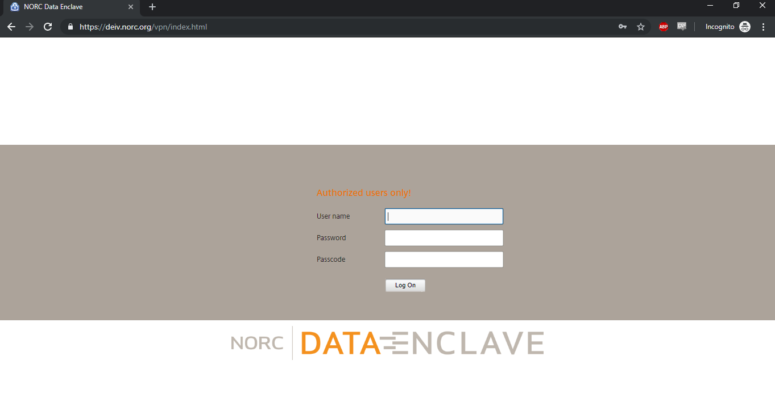
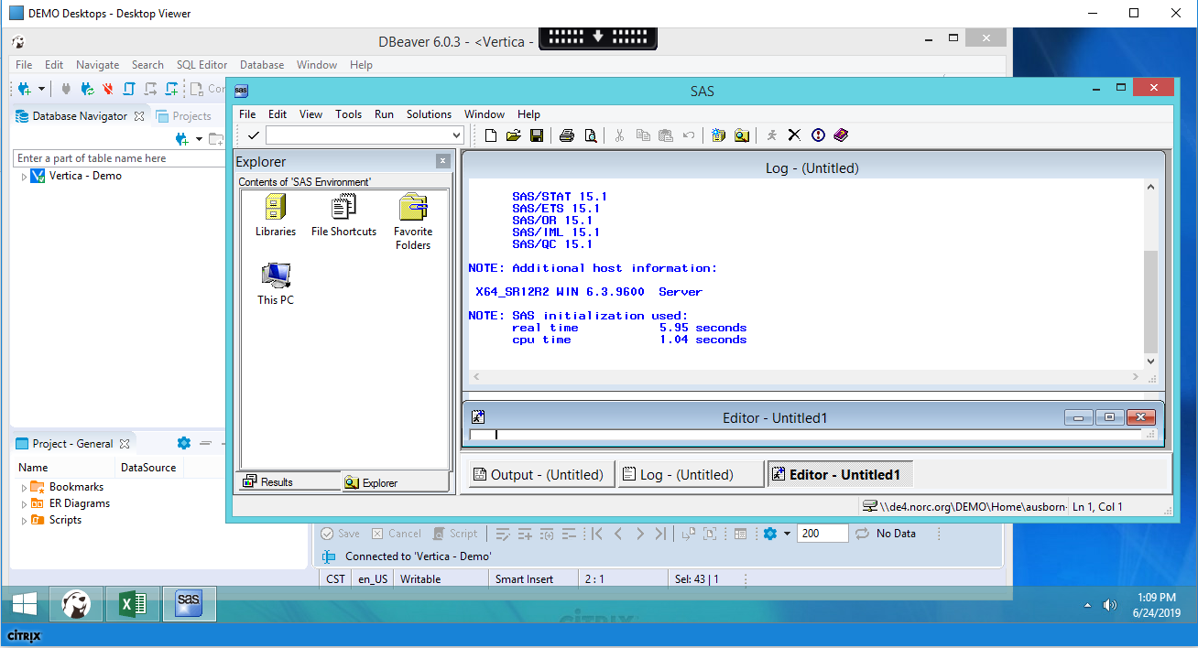
Data Enclave Demo

